Slide 1
Discourse particle in Hindi
LING 414 Statistical Methods in linguistics
Meghna Hooda

Slide 2
background
Discourse Particles convey information that is not always available in a proposition. It may provide information about the speaker's assumptions and reasoning on how the current discourse fits into the evolving common ground [5].
My research focuses on analyzing patterns of a discourse particle in Hindi speech.
Research in pragmatics and discourse markers [2,4] consistently shows:
  Discourse particles may mark speaker stance, pragmatic functions, and discourse structuring.
  They tend to appear in contexts with higher discourse complexity.
  Longer sentences consist of more complexities.
  Moreover, in German[3], Hindi[1], Japanese, particles frequently occur at clause boundaries (which longer sentences contain more of).
[1] Deo, A. (2022). Could be stronger: Raising and resolving questions with Hindi= to. Language, 98(4), 716-748.
[2] Fraser, B. (1999). What are discourse markers?. Journal of pragmatics, 31(7), 931-952.
[3] Groz, (2020) Discourse Particle,The Companion to Semantics, ed. by Lisa Matthewson, Cécile Meier, Hotze Rullmann, and Thomas Ede Zimmermann. To be published by Wiley.
[4] Schiffrin, D. (1987). Discourse markers (No. 5). Cambridge University Press.
[5] Zimmerman, M. 2011. “Discourse Particles” in In P. Portner, C. Maienborn und K. von Heusinger (eds.), Semantics. (= Handbücher zur Sprach- und Kommunikationswissenschaft HSK 33.2). Berlin, Mouton de Gruyter. 2011-2038.

Slide 3
hypothesis
Corpus analysis of a discourse particle na in Hindi.
Effect of sentence length and position on the occurrence of na

Slide 4
Data
IIT Delhi Dialogue Corpus [4] a corpus of naturalistic Hindi speech.
The database comprises two sets; one is telephonic conversational data obtained from the CALLFRIEND Hindi project of the Linguistic Data Consortium (LDC) [5], and the other is face-to-face (collaborative task-oriented) conversations.
Telephonic conversation data for the current paper.
The telephonic conversation data is manually transcribed and manually checked for annotations, whereas face-to-face data does not undergo manual checks. For this research I will take only telephonic conversation data which consists of 39,224 sentences.
[4] Canavan, A., & Zipperlen, G. (1996). Callfriend hindi ldc96s52. Web Download.Philadelphia: Linguistic Data Consortium.
[5] Pareek, B., Zafar, M., Hooda, M., Yadav, K., Vaidya, A., & Husain, S. (2025). IIT Delhi Dialogue Corpus: A Quantitative Analysis of a Spoken Corpus of Hindi. Language Resources and Evaluation. doi: 10.1007/s10579-025-09867-8

Slide 5
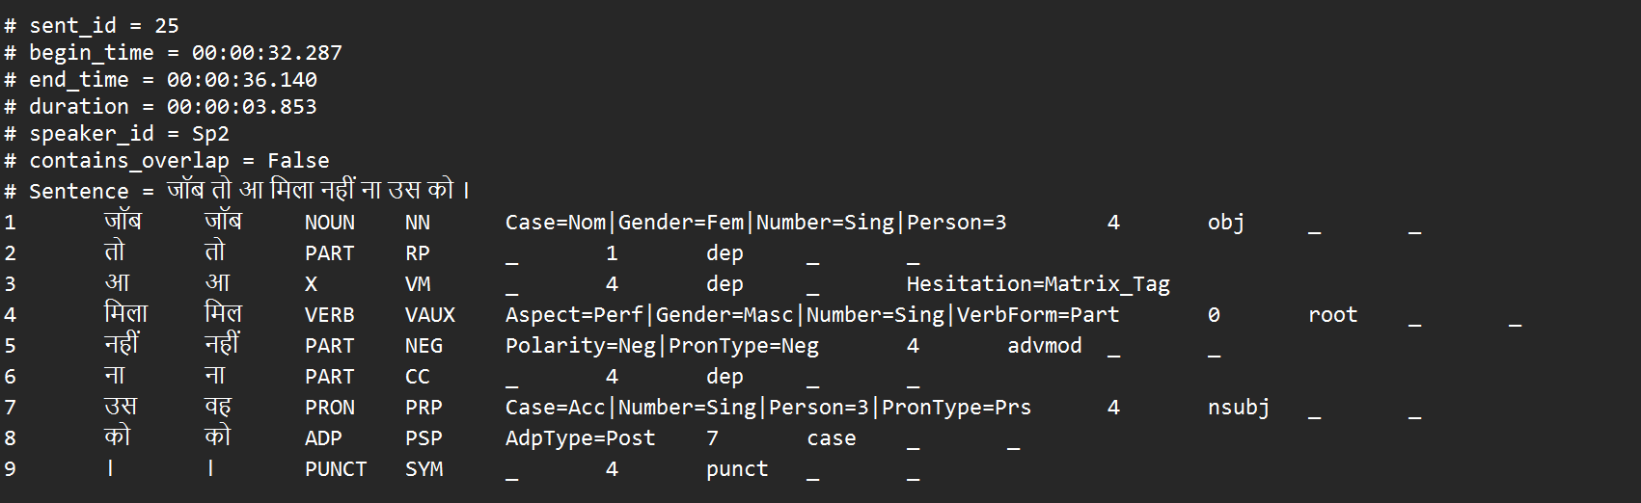
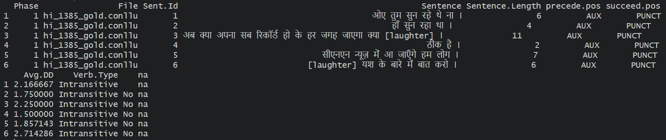
Data
.conllu file
head(na_data)

Slide 6
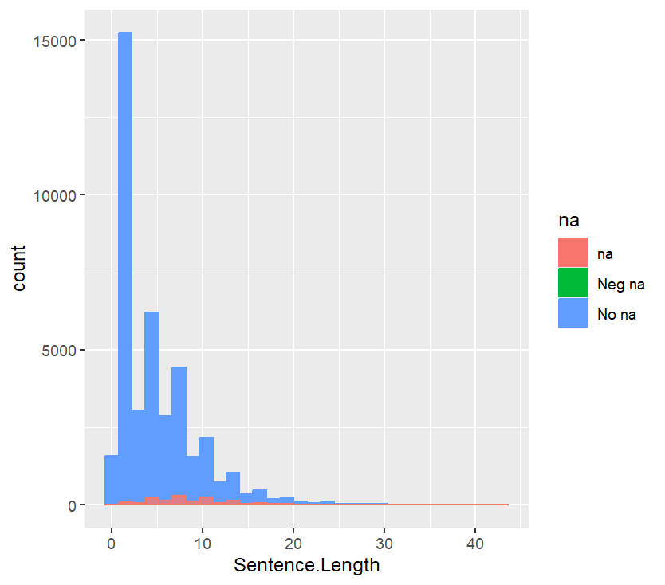
Analysis
Effect of sentence length and position on the occurrence of na
Data: Total number of occurrence with na and without na.
Note that if a sentence contains 2 instances of na, it will be recorded twice.
As part of the pre-processing the data do not contain the sentence which have negation na.
Generalised linear model for this data on r since outcome variable is binary.
With na | 1457 sentences
Without na | 40415 sentences
Total | 41,912 sentences
DV: Presence of na
IV: Sentence length, Clause final na

Slide 7
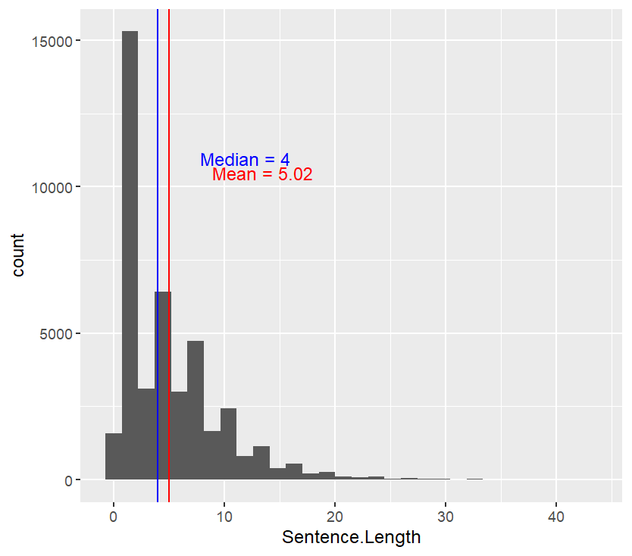
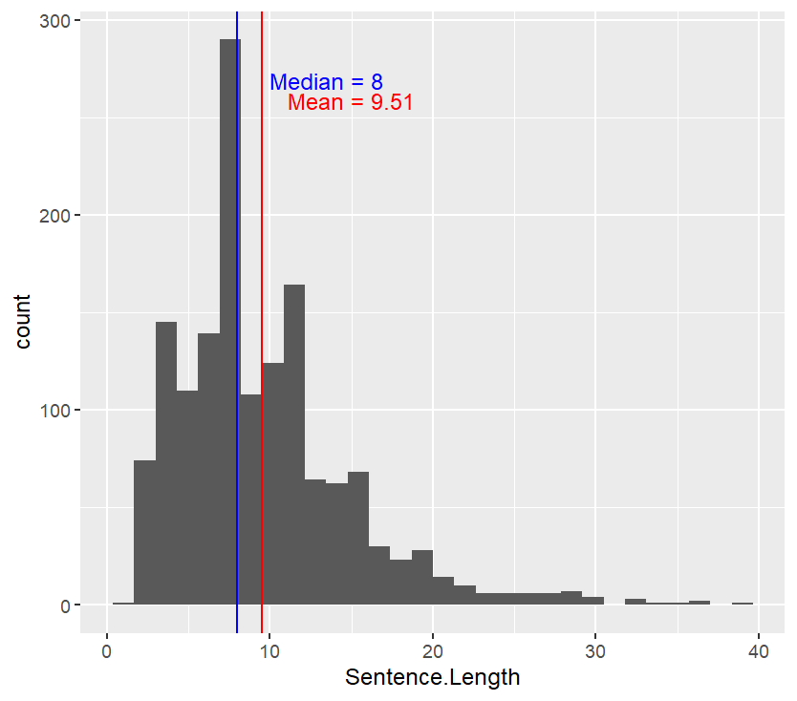
Analysis
na Data
All Data
Sentences containing na are generally longer than average sentences.

Slide 8
analysis
Convert na into binary target variable for logistic regression (0 = absent, 1 = present) :
Outcome variable : Presence of na (Type.of.na)
Predictors:
Sentence Length: continuous
Clause final(na.position): categorical

Slide 9
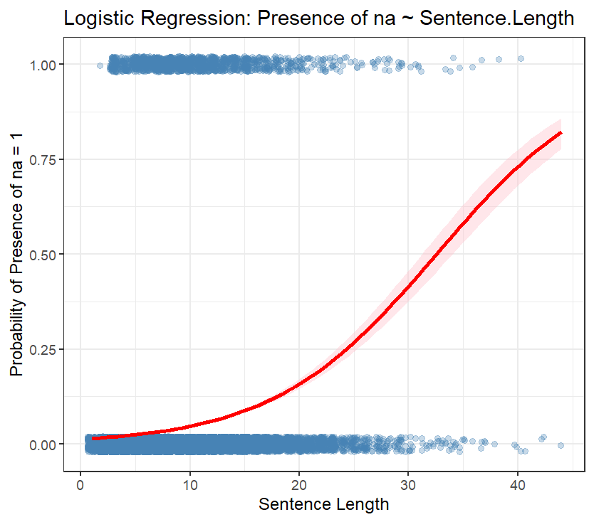
Model 1
β0​+β1​⋅Sentence.Length
Longer sentences slightly increase odds of na
Residual deviance: 11872 → good model fit for binary outcome
Coefficient | Estimate | Std. Error | z value | p-value
Intercept | -4.234 | 0.0443 | -95.58 | <2e-16
Sentence Length | 0.139 | 0.0040 | 34.34 | <2e-16

Slide 10
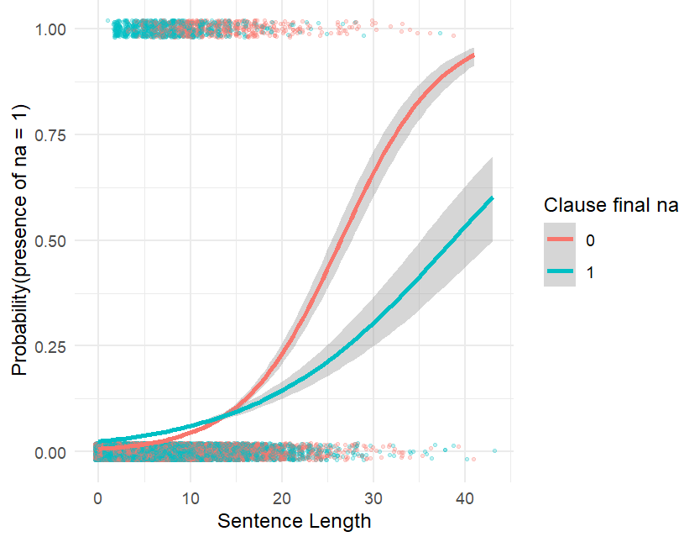
Model 2
β0​+β1​⋅Sentence.Length+β2​⋅na.position+β3​⋅(Sentence.Length×na.position)
Clause final na =1
Coefficient | Estimate | z value | p-value
Intercept | -4.928 | -65.33 | <2e-16
Sentence.Length | 0.186 | 31.36 | <2e-16
Clause.Final 1 | 1.242 | 13.28 | <2e-16
Sentence.Length:position1 | -0.091 | -10.83 | <2e-16
Intercept: baseline for presence of na =1 at sentence length =0
Sentence.length: longer sentences increase probability of na
Clause Final na is more likely.
Interaction: the increase in probability with length is smaller with clause final na
Effect of sentence length gets weeker by clause final na.

Slide 11
conclusion
Logistic regression successfully models probability of na occurrence
Sentence length and clause position both significantly influence na presence
Interaction shows position moderates the effect of sentence length

